Slide 1

“STOCK INVENTORY WEBSITE”
Task - 2

Slide 2
STOCK INVENTORY WEBSITE
Stock Inventory website stores the product details and also the stock. It provides the interface to users to manage the daily transaction and the previous data. It maintenances the report about the monthly inwards ,monthly returns and monthly deliveries.
LMS Username | Name | Batch
2115a91 | AARTHY.K | A9
2115a92 | AASHA.M | A9
2115a916 | DHANU SRI M.R | A9
2115a946 | SNEGAA.S | A9

Slide 3
Task - 2
Create various Front End Programs
Draw and design a uniform front end code for calculator
Draw and design a interactive front end code for text-editor
Evaluation Metric:
100% Completion of the above tasks
Learning Outcome
Get to know about concepts of project bucketing
Knowing about various frontend development framework like angular, vue,react
Know about various react topics like components, props, state, life cycle etc.

Slide 4
login.html
<!DOCTYPE html>
<html>
<head>
<title>
Login
</title>
<link rel="stylesheet" type="text/css" href="login.css">
</head>
<body class="container">
<div >
<div class="loginHeader">
<h1>SIM</h1>
<p> STOCK INVENTORY SYSTEM</p>
</div>
<div class="loginBody">

Slide 5
<form action="">
<div class="loginInputsContainer">
<label for=""> USERNAME</label>
<input placeholder="username" type="text"/>
</div>
<div class="loginInputsContainer">
<label for="">PASSWORD</label>
<input placeholder="password" type="password"/>
</div>
<div class="loginButtonContainer">
<button>login</button>
</div>
</form>
</div>
</div>
</body>
</html>

Slide 6
login.css
.container{
background: url('s1.jpg') no-repeat center center fixed ;
background-size: cover;
}
div.loginHeader{
margin-bottom: 50px;
}
div.loginHeader{
text-align: center;
}
div.loginHeader h1{
font-size: 100px;
color:#e26939;
padding:0px;
margin:0px;
}

Slide 7
div.loginBody form{
margin: 0 auto;
width:200px ;
background: rgb(238, 161, 97);
padding: 50px;
border:2px solid #000 ;
border-radius: 8px;
}
div.loginInputsContainer {
margin-top: 20px;
}
div.loginInputsContainer label{
text-transform: uppercase;
font-size: 20px;
font-weight: bold;
}

Slide 8
div.loginInputsContainer input{
height: 25px;
width: 100%;
border: 2px solid #000;
font-size: 20px;
padding: 5px;
text-align: center;
}
div.loginButtonContainer{
margin-top: 40px;
text-align: center;
}
div.loginButtonContainer button{
font-size:20px ;
padding: 10px 40px;
background: #072786;
border: none;

Slide 9
color: #f0e8e4;
}
Homepage.html
<!DOCTYPE html>
<html>
<head>
<title>SIM Homepage - Stock Inventory System</title>
<link rel="stylesheet" type="text/css" href="Homepage.css">
<script src="https://use.fontawesome.com/0c7a3095b5.js"></script>
</head>
<body>
<div class="header">
<a href="login.html">LOGIN</a>
</div>
<div class="banner">
<div class="homepageContainer">
<div class="bannerHeader">

Slide 10
<h1>SIM</h1>
<p>Stock Inventory System</p>
</div>
<p class="bannerTagline">
Track your goods throughout your entire supply
<br>chain, from purchasing to production to end sales
</p>
<div class="bannerIcons">
<a href=""><i class="fa fa-apple"></i></a>
<a href=""><i class="fa fa-android"></i></a>
<a href=""><i class="fa fa-windows"></i></a>
</div>
</div>
<p class="bannerTagline">
Track your goods throughout your entire supply
<br>chain, from purchasing to production to end sales
</p>

Slide 11
<div class="bannerIcons">
<a href=""><i class="fa fa-apple"></i></a>
<a href=""><i class="fa fa-android"></i></a>
<a href=""><i class="fa fa-windows"></i></a>
</div>
</div></div>
</div>
</body>
</html>

Slide 12
Homepage.css
body{
font-family: Arial;
}
div.header{
width: 100%;
background:#e26939 ;
padding:10px 0px ;
text-align: right;
}
div.header a{
font-size:20px ;
color: #fff;
padding: 5px 10px;
text-decoration: none;
border: 2px solid transparent;
border-bottom: 2px solid #fff;}

Slide 13
div.header a:hover{
border-radius: 5px;
border: 2px solid #fff;
}
div.banner{
background: url('s5.jpeg') no-repeat center center fixed ;
background-size: cove r;
padding-top: 100px;
padding-bottom: 80px;
}
div.homepageContainer{
width:100% ;
max-width:900px;
height: 70vh;
margin: 0 auto;
}

Slide 14
div.bannerHeader h1{
font-size: 100px;
color: #e26939;
}
div.bannerHeader p{
font-size: 30px;
color: #e94a0b;
text-transform: uppercase;
margin-top: 0px;
}
p.bannerTagline{
font-size: 25px;
margin-top: 20px;
color: #eee7e7;
}

Slide 15
div.bannerIcons{
margin-top: 50px;
}
div.bannerIcons a{
font-size: 23px;
margin-left:40px ;
padding: 25px;
background: rgba(245, 238, 238, 0.76);
color: #db6e09;
border-radius: 50%;
}
div.bannerIcons a:first-child{
margin-left: 0px;
}

Slide 16
div.bannerIcons a:hover{
color:#fff ;
font-size: 25px;
background: #3e80e2;
transition: .5s all;
}
div.homepageNotified{
display:flex;
flex-direction: row;
padding: 50px 0px;
}
div.homepageNotified h3{
margin-bottom: 20px;
font-size: 30px;
}

Slide 17
div.homepageNotified p{
color: #c421c4;
font-size: 20px;
}
div.formContainer{
width: 80%;
position: relative;
}
div.formContainer input{
width: 100%;
padding: 15px 10px;
}

Slide 18
div.formContainer button{
font-size: 22px;
padding: 0px 10px;
background: #f7953a;
border: none;
color: #fff;
}

Slide 19
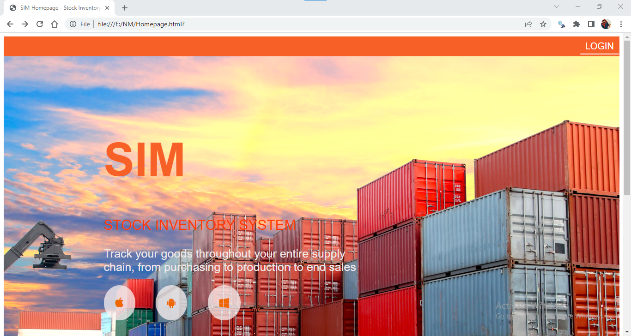
Output:

Slide 20
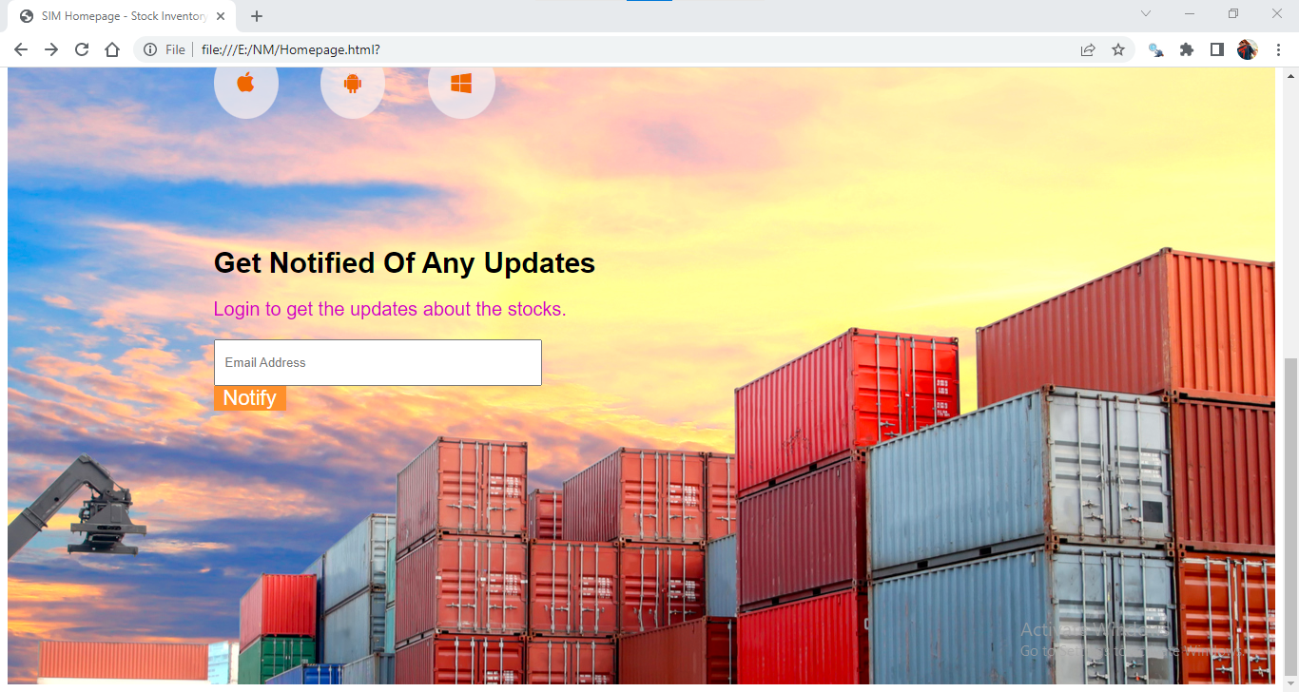

Slide 21


Slide 22
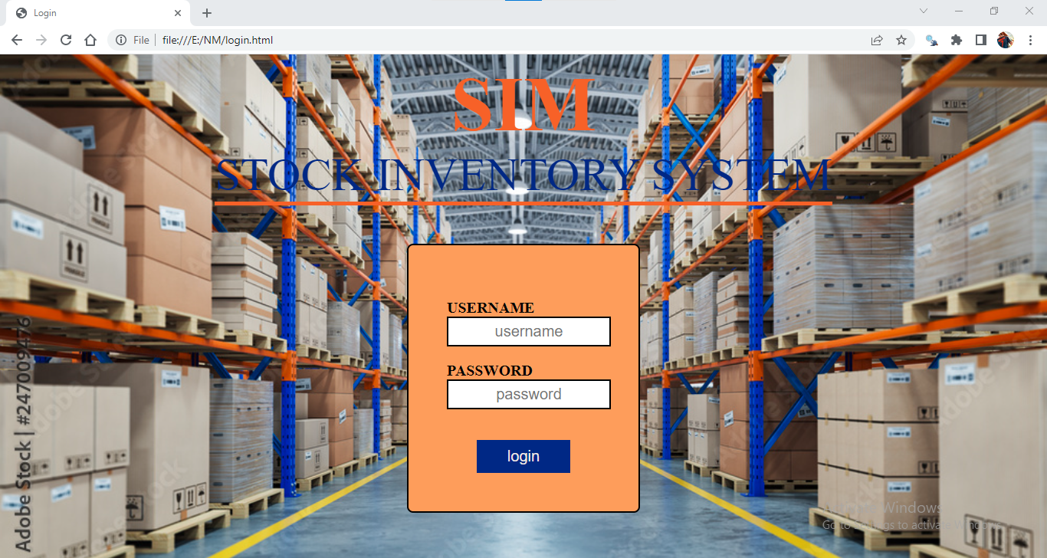

Slide 23
Assessment Parameter
Setup Project for Calculator project
Setup basic structure of text-editor project
Create a main component with the outer structure of calculator
Check-List
Create main component with all feature buttons
Create a button component with on click handler
Create a json object to store data for text editor
Create a ` evaluateExpresion` function to evaluate value
Push both code to github

Slide 24
Submission Github
https://github.com/aarthy03/Stock-Inventory-Website

